Slide 1
7th March 2021 Officials & Volunteers Well-being

Slide 2
Introduction
What is well-being?
Why is well-being important?
How can we look after our own well-being?

Slide 3
Research suggests volunteering boosts happiness & well-being

Slide 5
Did you know?
1 in 4 of us will experience a mental health problem in any given year, which is why talking about mental health is so important.
It’s a chance for all of us to open up to mental health – to talk, to listen, to change lives.
A small conversation about mental health has the power to make a big difference.

Slide 6
Olympian Kelly Holmes talking about mental health

Slide 7
What is well-being?
Well-being
Physical
Social
Environment
Psychological

Slide 8
Why is mental well-being important?
To be able to manage our life more effectively
Reduce and manage stress
Reduce sickness and promote healthy lifestyles
Increased productivity and satisfaction
Promote good work/life balance
Engaging, meaningful and positive communication

Slide 9
“BURNOUT IS A STATE OF EMOTIONAL, PHYSICAL, AND MENTAL EXHAUSTION CAUSED BY EXCESSIVE AND PROLONGED STRESS. IT OCCURS WHEN YOU FEEL OVERWHELMED, EMOTIONALLY DRAINED, AND UNABLE TO MEET CONSTANT DEMANDS.”
Source: HelpGuide.org.uk

Slide 10
Signs of burnout
Insomnia, disturbed sleep or exhaustion
Decreasing concentration or increased forgetfulness
Physical symptoms
Increased anxiety or anger
Decreased enjoyment and unusual changes in attitude
Disconnect, apathy or hopelessness

Slide 11
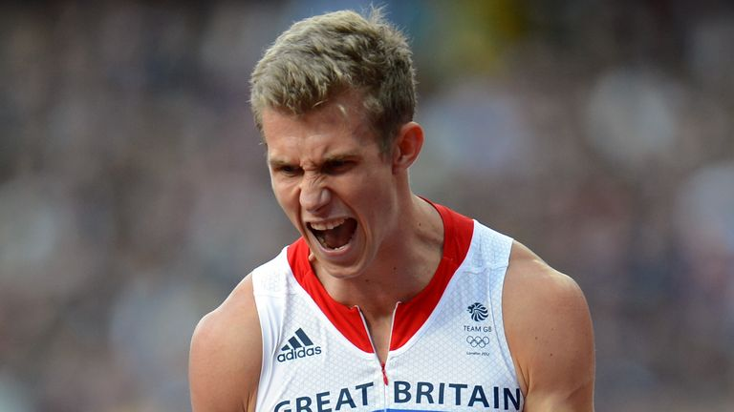
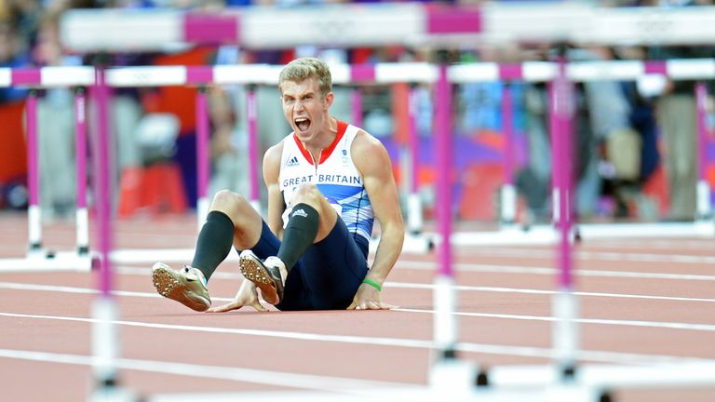
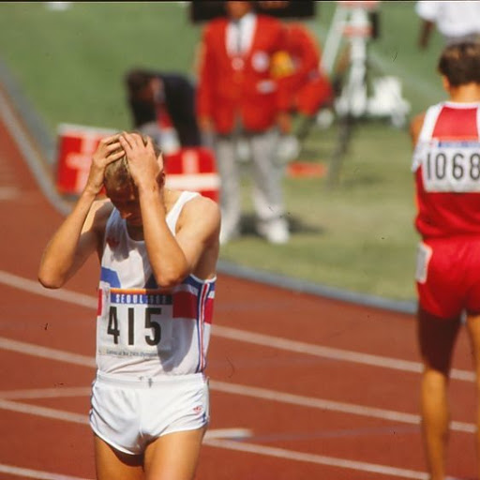
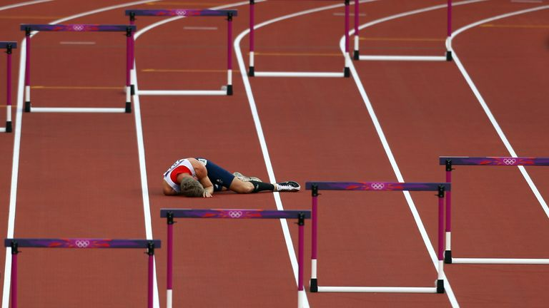
Mental health flags
Physical
Mental
Behaviour
Notes:
1988 Seoul Olympics - Mens 1500m Final Great Britain's Steve Cram holds his head in his hands after finishing in fourth place in the Olympic Stadium, Seoul Sports Complex, Seoul, South Korea.
Jack Green images screaming after falling in the 400m hurdles semi-finals at the 2012 Olympics
The 28-year-old is a two-time Olympian, having competed in the 400m hurdles at the 2012 Games in London and in Rio four years later, also forming part of the 4x400m team to finish fourth in London.
“For someone with mental health problems it’s tough giving your whole life to track and field. You have to find the balance,” he said then.
I had every intention of training towards a third Olympic Games but after taking some time out and learning more about myself I came to realise that I wasn’t willing to give myself to the sport and make the necessary sacrifices to be the best I could be on the track.
“I was not willing to lose myself or anything else in the hunt for Olympic success. There’s a damn sight more to life than running around and after nearly 10 years at the elite level I’m more than happy to move forward with the next part of my story.
“I finish my athletics career having represented my country at every major championships possible, including two Olympics. This was something I dreamt of as an eight-year-old.I didn’t quite get the gold but I did achieve my dream!
Fourth at the Olympics, bronze medals from the Worlds and Europeans and a fourth at the Commonwealths.

Slide 12
How look after your own mental well-being?
Prioritise
Take time for yourself
Share your problems, discuss solutions
Eat well, sleep well, exercise well
There are many ways to look after your mental wellbeing. What will work best for you?

Slide 13
Keeping CALM because you matter
Using CALM may help you to take care of your feelings, your body, your thoughts and what you are doing.
Calming Activities - relaxation, seeking reassurance and mindfulness practices
Attending to basic needs - thinking carefully about your sleep, exercise, nutrition
Learning to re-think - avoiding rumours, limiting media coverage, thinking in the here and now
Making yourself feel good - doing things that bring you joy and take your mind off your worries

Slide 14
What helps you to relax?

Slide 15
8 Top tips for RELAXATION

Slide 16
Consider… how to improve your well-being?
One thing you will stop doing
One thing you will start doing
One thing you will continue doing

Slide 17
helpful resources
HEADSPACE APP
Mindfulness shares accessible guided meditations, animations, articles and videos
Mind 24 hour helpline 03001233393
Samaritans helpline 116 123
24-hour emotional support for anyone who needs to talk, available in English and Welsh.
For more details email officials@welshathletics.org

